Slide 1
Electron Shell Activity
First 20 Elements Day 6

Slide 2
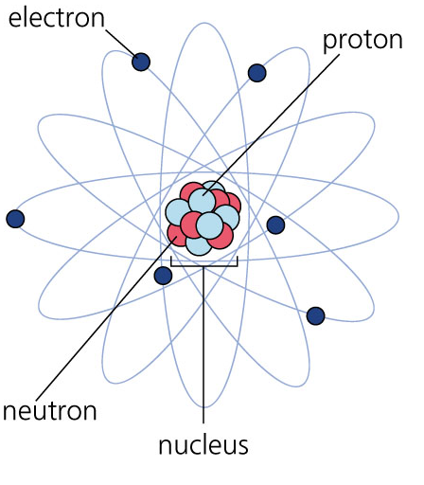
Atomic Structure Recap
Protons
Have a positive (+) charge
Are located in the nucleus
Neutrons
Have a neutral (0) charge
Are located in the nucleus
Electrons
Have a negative (-) charge
Are located outside the nucleus
Are always moving very fast

Slide 3
Atomic Model Rules
Nucleus (Shaded Area)
Protons are located in the nucleus
Neutrons are located in the nucleus
Electron Energy Shells (Numbered Rings)
Electrons are located outside the nucleus
Electrons follow these special rules
Maximum of two electrons in the first ring
Maximum of eight electrons in the second ring
Maximum of eight electrons in the third ring
You must fill up the lower rings before moving to higher rings
Valence Electrons
The number of electrons in the outer most ring (energy shell)

Slide 4
Element Name:
4
3
Atomic Number: _____
Atomic Mass: _____
# of Protons: _____
# of Neutrons: _____
# of Electrons: _____
# of Valence Electrons: _____
2
1
Nucleus

Slide 5
Element Name:
4
3
Atomic Number: _____
Atomic Mass: _____
# of Protons: _____
# of Neutrons: _____
# of Electrons: _____
# of Valence Electrons: _____
2
1
Nucleus

Slide 6
Instructions – Individual Elements
Each student is assigned two different elements
Use the glitter stones to complete an electron shell diagram for your assigned elements
Follow the “Atomic Model Rules” handout
Glitter Stones key:
Red – Protons
White – Neutrons
Diamond - Electrons

Slide 7
Instructions – Grouping Elements
Work in teams
Each team is assigned a “Valence” Number
Collect all the Elements with the valence number as your team number
Organize your elements in order from smallest to biggest (make a column)
Tape your elements on the classroom poster according to instructions from your teacher

